Slide 1


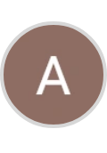
Spiral Model in Software Development
Author: ABDELMALEK MOHAMMEDRIAD

Slide 2

CONTENTS
1. Definition
2. Main Idea
3. Structure
4. Diagram Explanation
5. Phases in Spiral Model
6. When to Use the Spiral Model
7. Example Scenario
8. Comparative Statistics — Spiral vs Other Models
9. Detailed Phase Table — Spiral Cycle Breakdown

Slide 3

1. Definition
The Spiral Model is a risk-driven software development process model that combines elements of both Waterfall and Iterative models. It was proposed by Barry Boehm in 1986.
It’s called spiral because the development process passes through repeated loops (spirals) — each representing a phase of the software with planning, risk analysis, development, and evaluation.

Slide 4

2. Main Idea
Unlike traditional linear models (like Waterfall), the Spiral Model iterates through several versions of the software — each cycle adds more detail and functionality. At every spiral, risks are identified, analyzed, and managed before moving to the next phase.

Slide 5
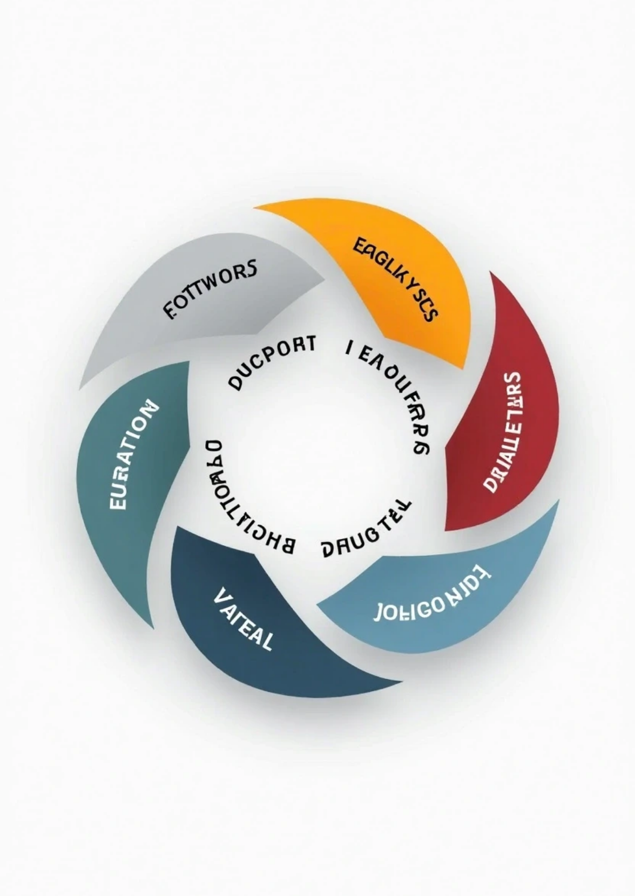
3. Structure
Each loop in the spiral represents a phase in the software process and is divided into four main quadrants:

Slide 6

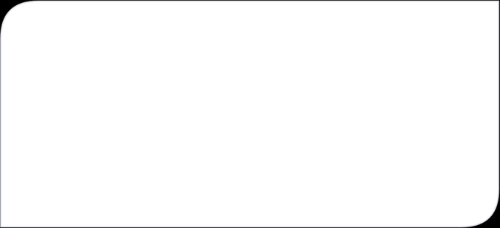
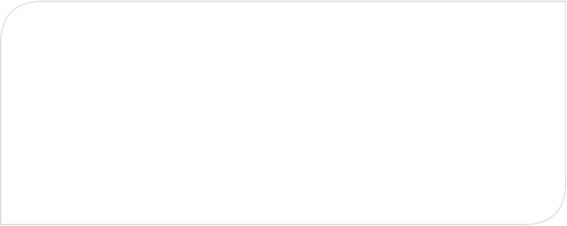
Structure
Planning (Objective setting)
Risk Analysis (Evaluation and alternatives)
• Identify the system’s objectives, alternatives, and constraints: Determine what needs to be built in this iteration.
• Identify potential risks (technical, financial, time-related, etc.): Analyze and find ways to mitigate or reduce risks.\
This is the most important and unique part of the Spiral Model.
• Define requirements for that phase: Example: Define what features to include in the next prototype. Gather user requirements.
• Example: Risk: New technology might not integrate with existing systems. Solution: Build a small prototype to test compatibility.
Engineering (Development and testing)
Evaluation (Customer feedback)
• Actually develop the product for that cycle (coding, testing, etc.): Produce a working model, prototype, or part of the system.
• The customer reviews the result and gives feedback: This helps decide whether to continue to the next loop or adjust requirements.
• Example: Implement a module, then test and validate it.
• Example: Users test the prototype and report usability issues. Developers use this feedback to plan the next iteration.

Slide 7





4. Diagram Explanation
Imagine a spiral starting at the center and expanding outward. Each loop (cycle) passes through:
Planning → Risk Analysis → Engineering → Evaluation and then moves to the next spiral with updated requirements and lower risks.
1
2
The radius of the spiral = progress in the project.
The angle of the spiral = cost incurred so far.

Slide 8
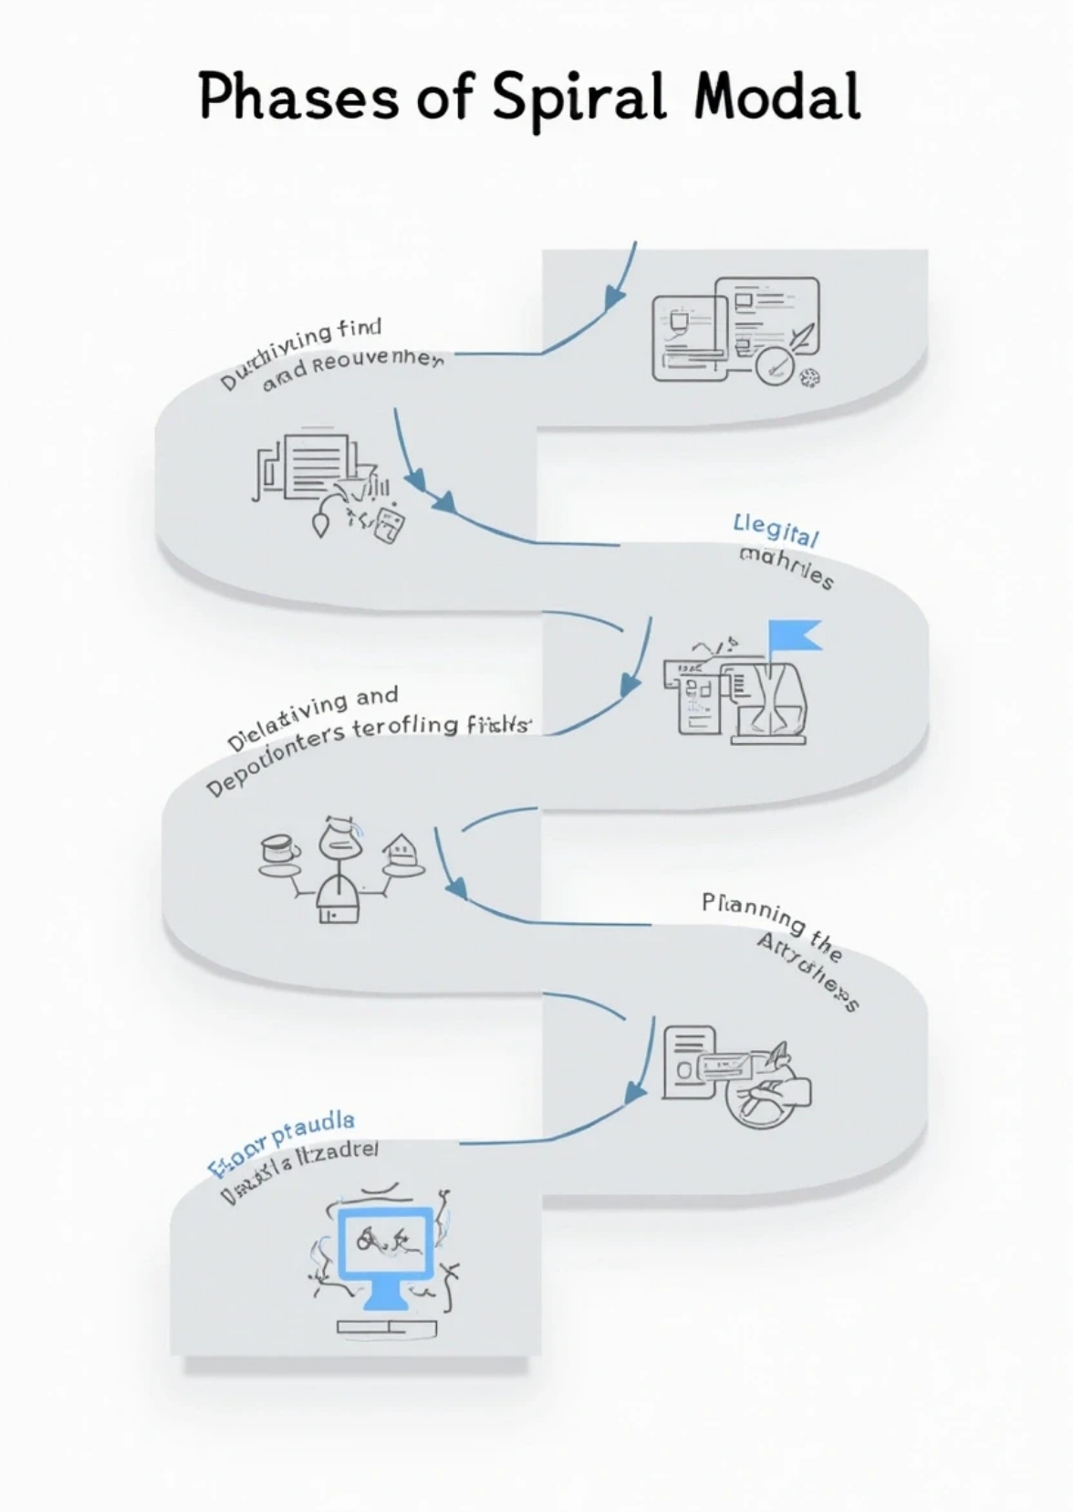
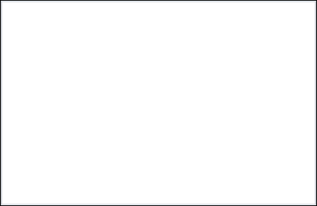

5. Phases in Spiral Model
Determining Objectives
Identifying and Resolving Risks
Define the purpose, requirements, and constraints.
Analyze risks and possible solutions.
Development and Testing
Planning the Next Iteration
Build and verify the product incrementally.
Prepare for the next loop using feedback.

Slide 9






6. When to Use the Spiral Model
Use it when:
1
2
The project is large and complex.
Requirements are unclear or evolving.
3
4
High risk is involved (technical or business).
Early user feedback is critical.
5
You need prototyping and incremental delivery.
Examples:
1
2
3
Defense systems
Aerospace projects
Large enterprise software with changing requirements

Slide 10
7. Example Scenario
Let’s say you’re building a banking system:
1st Spiral – Requirement gathering + prototype login module
2nd Spiral – Add transaction and account modules
3rd Spiral – Add security and reporting features
4th Spiral – System testing and deployment
Each spiral reduces uncertainty and adds functionality.
Aspect | Description
Model Name | Spiral Model
Proposed By | Barry Boehm (1986)
Main Idea | Combines Waterfall and Prototyping in an iterative, risk-driven process
Focus | Risk management and iterative refinement
Output of Each Cycle | A working prototype or refined version of the product
Best For | Large, high-risk, or complex projects
Customer Involvement | Very high — continuous feedback each iteration
Development Type | Iterative and evolutionary

Slide 11
8. Comparative Statistics — Spiral vs Other Models
Criteria | Waterfall | Agile | Spiral
Customer Involvement | Low | High | Very High
Risk Management | Weak | Medium | Strong
Flexibility in Requirements | Low | High | High
Cost of Change (Late Stages) | Very High | Medium | Medium
Documentation Required | Very High | Low | High
Iteration Cycles | 1 (sequential) | Many | Many
Best For | Stable, small projects | Fast-paced projects | Complex, risky systems
🧠 Statistically (based on industry data):
Projects using the Spiral Model report 30–40% fewer failures in high-risk environments compared to Waterfall.
However, development cost can be 15–25% higher due to repeated risk assessments.

Slide 12

9. Detailed Phase Table — Spiral Cycle Breakdown
Phase | Activities | Output | Participants
Planning | Define objectives, alternatives, constraints | Requirements for this iteration | Analysts, Clients
Risk Analysis | Identify and analyze potential risks | Risk mitigation strategies | Developers, Managers
Engineering | Design, code, integrate, and test | Prototype or working version | Developers, Testers
Evaluation | Get customer feedback and assess progress | Updated requirements | Clients, QA Team
Iteration (Spiral) | Cost (Est.) | Risk Level | Progress (%) | Customer Satisfaction (%)
Spiral 1 | $20,000 | 🔴 High | 20% | 60%
Spiral 2 | $35,000 | 🟠 Medium | 50% | 75%
Spiral 3 | $45,000 | 🟢 Low | 80% | 90%
Spiral 4 | $50,000 | 🟢 Very Low | 100% | 95%
✅ Advantages:
Strong risk management
Early detection of issues
High customer involvement
Flexible for requirement changes
Delivers early prototypes
❌ Disadvantages:
Complex to manage
Expensive due to iterations
Needs expert risk analysts
Not suitable for small projects
Can take longer to complete

Slide 13

Thank You

